Slide 1


Software Implementation of LTE PHY.Layer.4G B.Sc. Graduation Project Supervisor Dr\Ahmed ABDULRAHMAN EMRAN
Al-Azhar University
Communication and Electronics Engineering

Slide 2
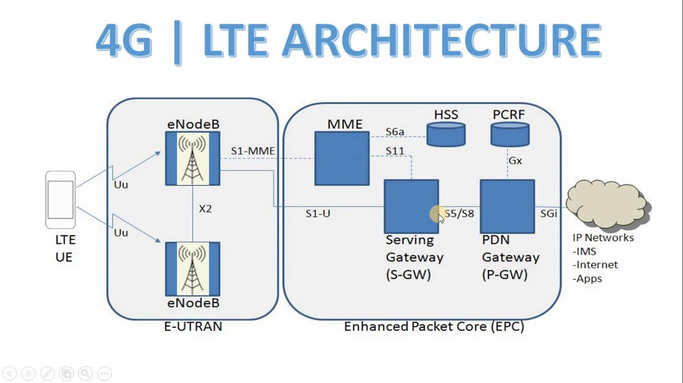
Scanning of LTE.
LTE is the next generation of Mobile broadband technology.
Data rates of 100 Mbps.
It is the next level after UMTS 3G technology.
Works with IP (VOIP).
Provides low latency.
Focus on packet switched domain.

Slide 3
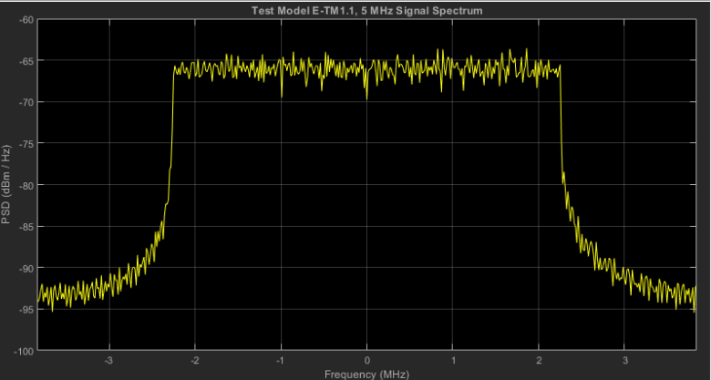
LTE. Requirements
3GPP. Release 16
Peak bit (not data) rate – 100 Mbps DL/ 50 Mbps UL within 20 MHz bandwidth (i.e., SISO).
Up to 200 active users in a cell (5 MHz).
Less than 5ms user-plane latency condition (i.e., single user with single data stream).
Mobility – Optimized for 0 ~ 15 km/h. – 15 ~ 120 km/h supported with high performance. – Supported up to 350 km/h or even up to 500 km/h.
Spectrum flexibility: 1.5 ~ 20 MHz.

Slide 4
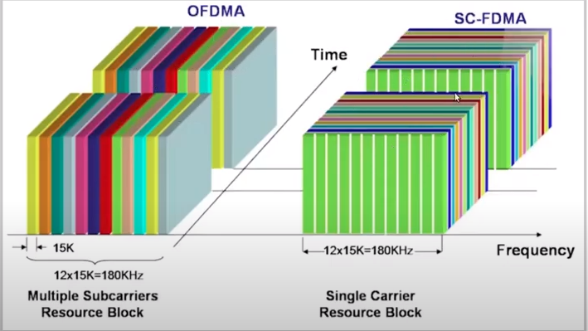
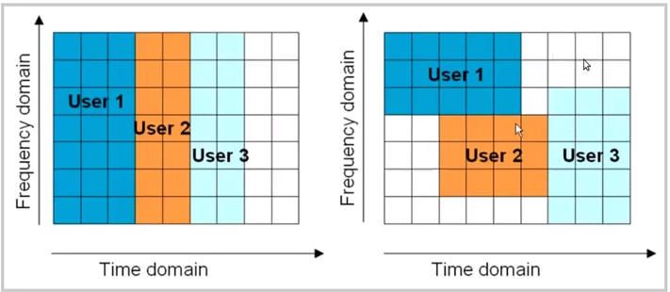
LTE. Enabling Technologies
OFDM- SC.FDMA
OFDM (Orthogonal Frequency Division Multiplexing) for Down Link.
Frequency domain equalization.
SC-FDMA (Single Carrier FDMA) for Up Link.
-Utilizes single carrier modulation and orthogonal frequency. -Multiplexing using DFT-spreading in the transmitter and frequency. domain equalization in the receiver. -A salient advantage of SC-FDMA over OFDM/OFDMA is low PAPR.
Efficient transmitter and improved cell-edge performance.
MIMO (Multi-Input Multi-Output).
-e.g., Open loop, Close loop, Diversity, Spatial multiplexing.
Multicarrier channel-dependent resource scheduling.
Fractional frequency reuse - Active interference avoidance and coordination

Slide 5
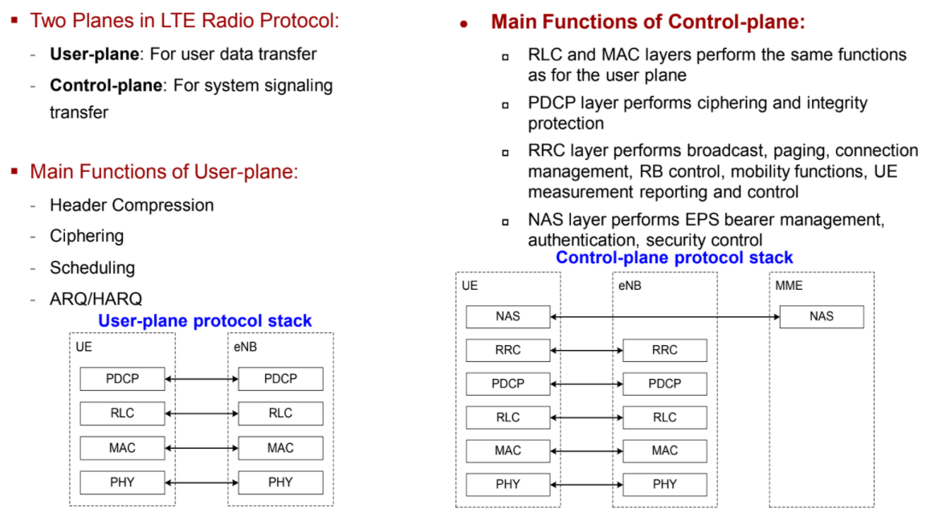
LTE. Radio protocol stack

Slide 6
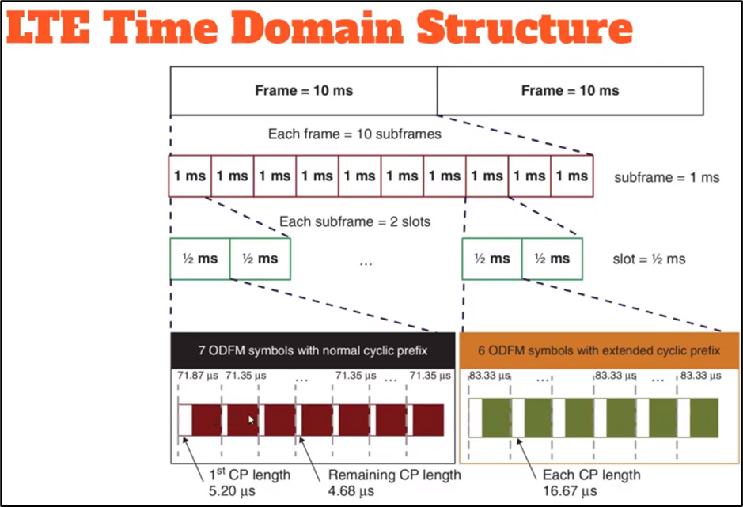
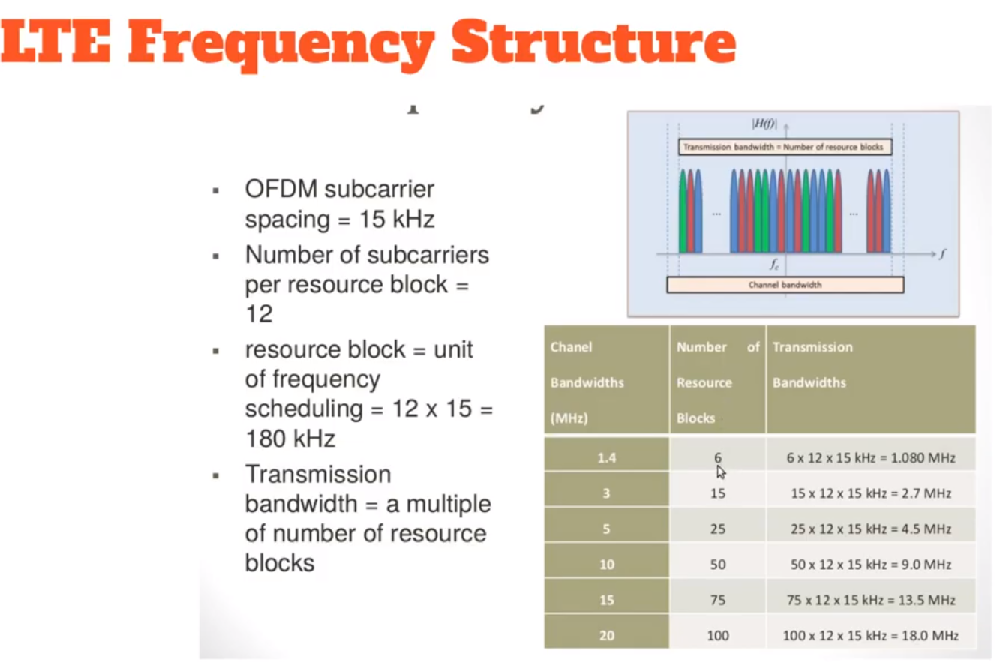
LTE. Downlink Physical channel

Slide 7
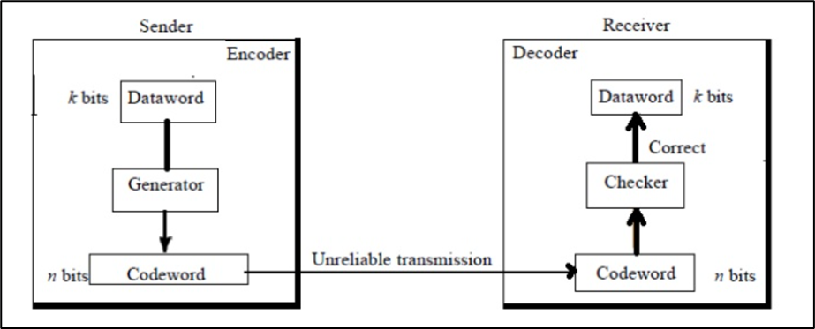
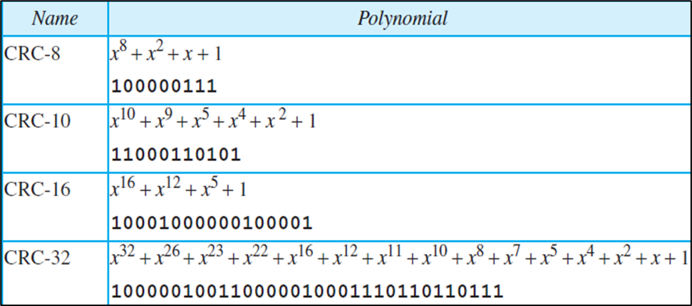
Cyclic Redundancy Check
Error detection is the detection of errors caused by noise or other impairments during transmission from the transmitter to the receiver. Summer is another name for error detection. The receiver can detect a change in the original code word. • 1. The receiver has (or can find) a list of valid code words.
• 2. The original code word has changed to an invalid one.
• Cyclic codes are special linear block codes with one extra property. In a cyclic code, if a code word is cyclically shifted (rotated), the result is another code word. • A cyclic redundancy check (CRC) is an error-detecting code commonly used in digital networks and storage devices to detect accidental changes to raw data. • Blocks of data entering these systems get a short check value attached, based on the remainder of a polynomial division of their contents; on retrieval the calculation is repeated, and corrective action can be taken against presumed data corruption if the check values do not match.

Slide 8
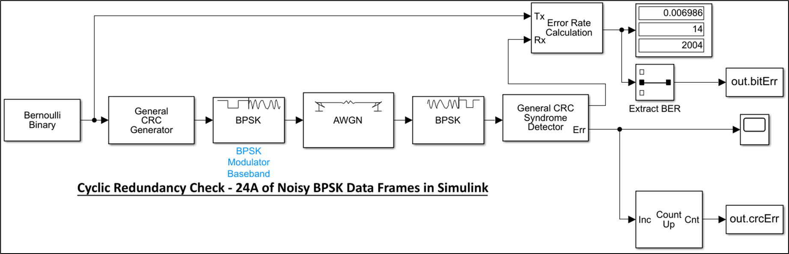
Cyclic Redundancy Check 24-a.of Noisy BPSK Data Frames in Simulink

Slide 9
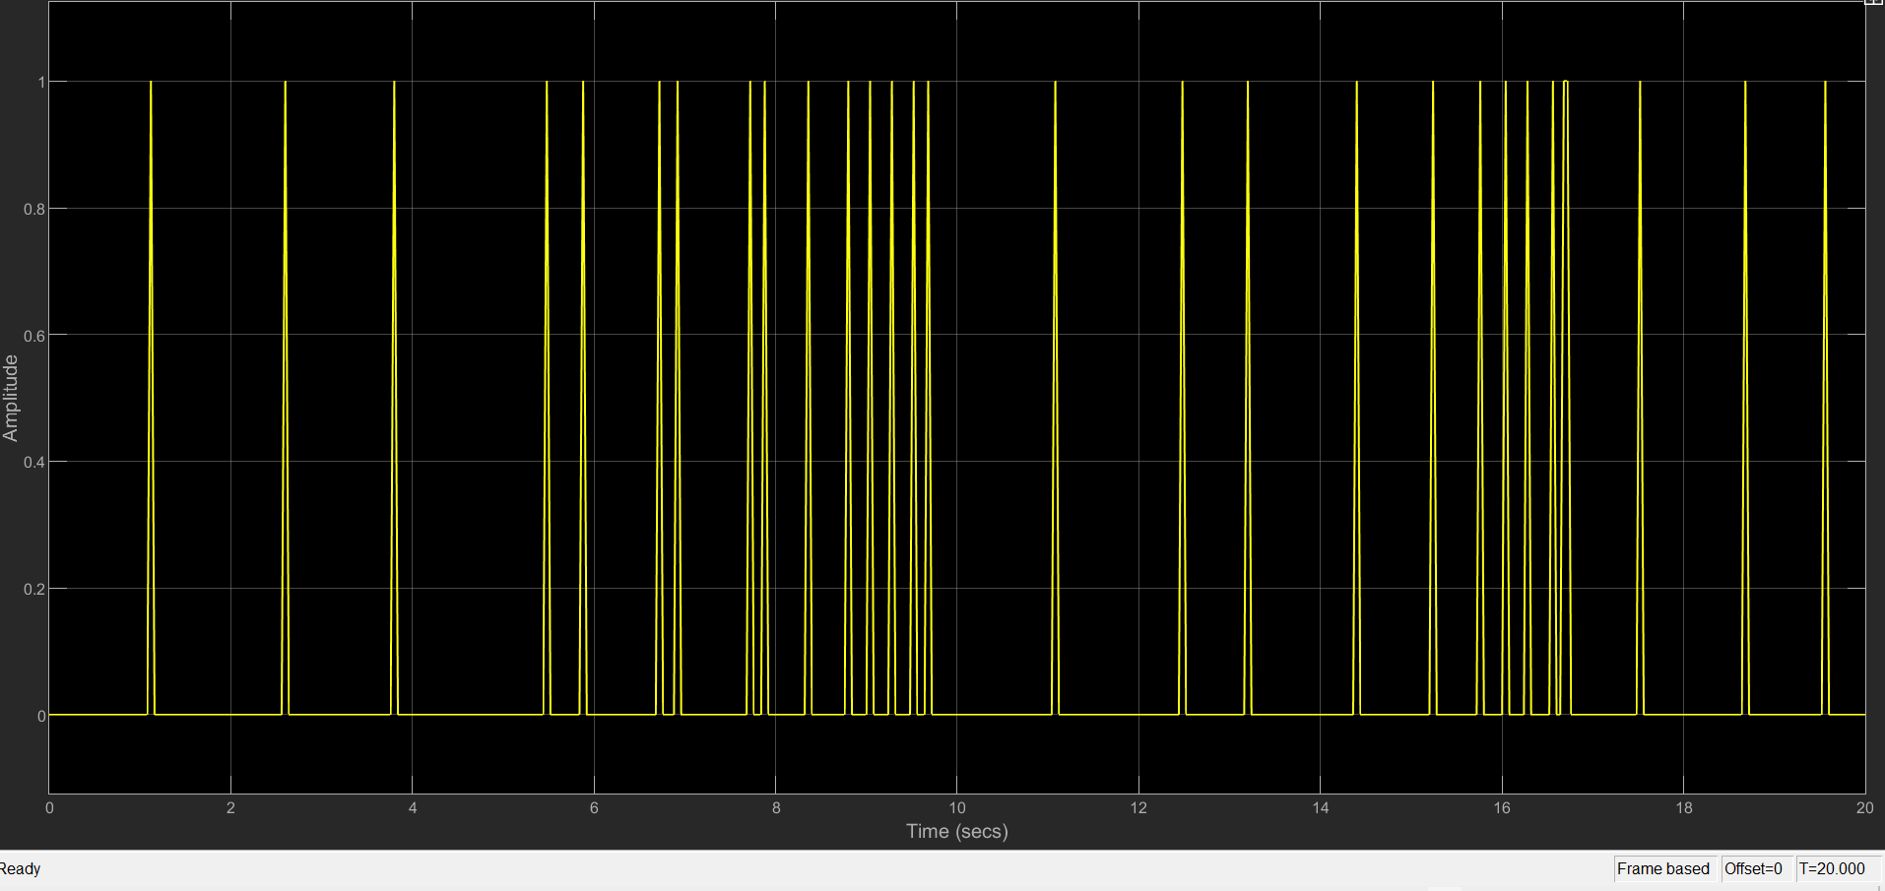
CYCLIC REDUNDANCY CHECK 24-A.OF NOISY BPSK DATA FRAMS IN SIMULINK – RESULT.

Slide 10
Turbo Codes Channel coding

Slide 11
What is turbo codes used for ?
It used for error detection and correction
Making higher Bit Error rate

Slide 12
Overview
Turbo Encoder
Rate Matching

Slide 13
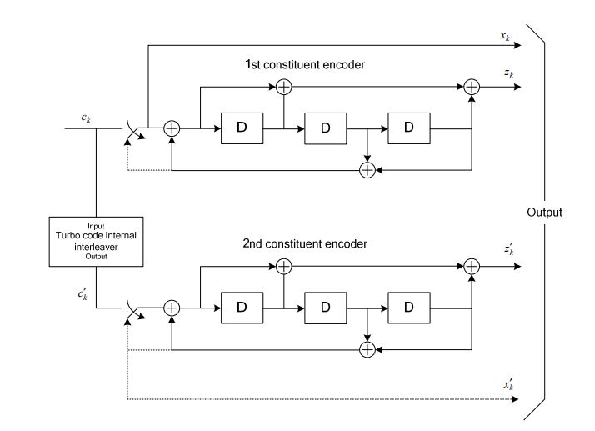
Turbo encoder
structure
The scheme of turbo encoder is a Parallel Concatenated Convolutional Code (PCCC)
The turbo code rate is 1/3

Slide 14
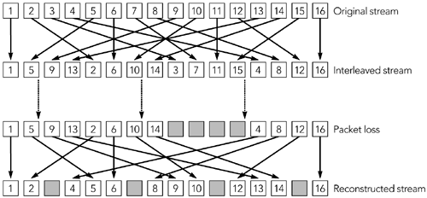
Interleaver

Slide 15
What is the rate matching ?
The basic function of rate matching module is to match the number of bits in transport block(TB) to the number of bits that can be transmitted in the given allocation
It reduce the length of the code based on the channel behavior

Slide 16
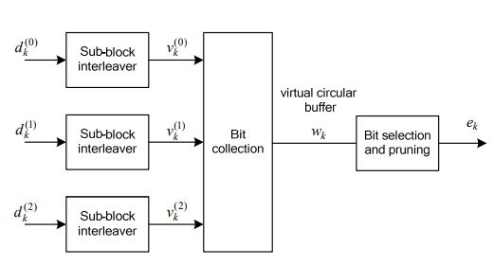
Rate Matching Structure
The rate matching consists of:
Sub-block interleaver
Circular Buffer
Bit Puncturing

Slide 17
Sub-block interleaver
The sub-block interleaver randomize the data of the encoder output
For the systematic bits and the first parity bits we use a method of the interleaver
For the second parity bits we use another method of interleaver

Slide 18
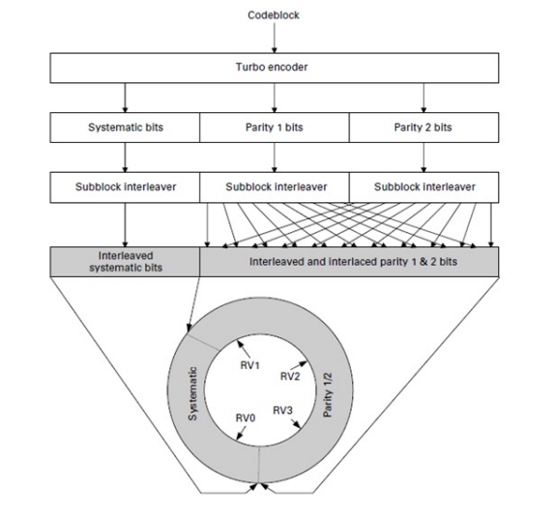
Circular Buffer
a single output buffer is formed by placing the rearranged systematic bits in the beginning followed by bit-by-bit interlacing of the two rearranged parity streams

Slide 19
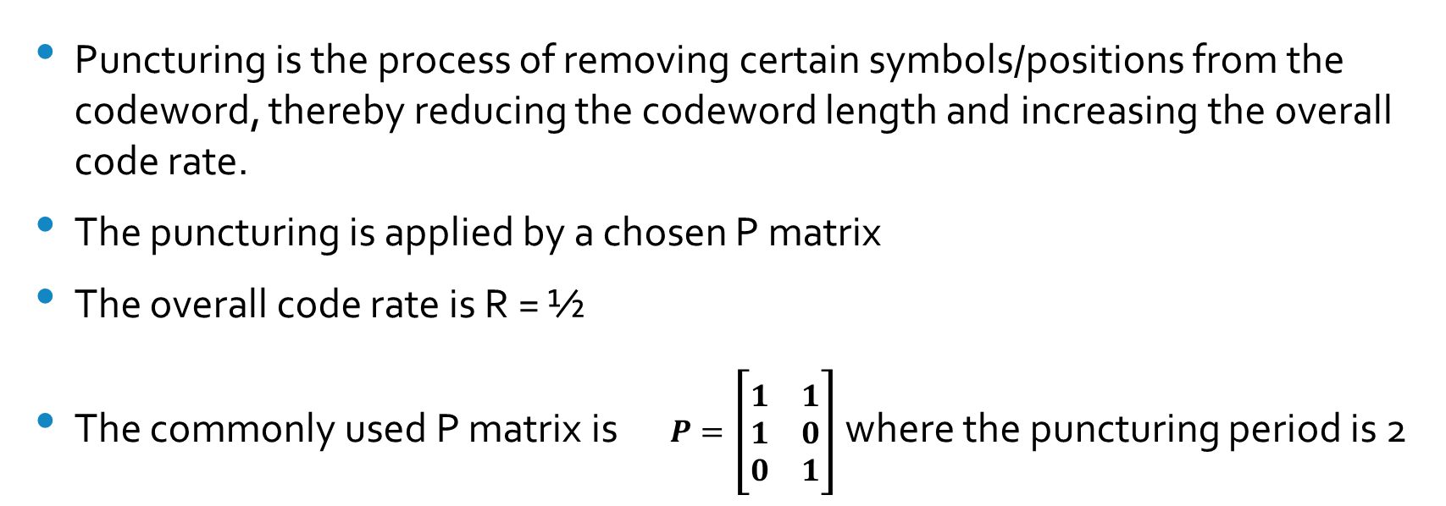
Puncturing
Puncturing is the process of removing certain symbols/positions from the codeword, thereby reducing the codeword length and increasing the overall code rate.
The puncturing is applied by a chosen P matrix
The overall code rate is R = ½
The commonly used P matrix is $P=\left[\begin{matrix}1 & 1 \\ 1 & 0 \\ 0 & 1\end{matrix}\right]$ where the puncturing period is 2

Slide 20
Turbo Decoder
u=[u₁, …, u_{k}, …,u_{N}]
x^{s}
y^{s}
In the receiver, the turbo decoder inverts the operations performed by the turbo encoder
that turbo decoder depend on iterative operation
Turbo
Decoding
RSC Encoder 1
x^{1p}
y^{1p}
x
y
u*
MUX
Channel
DEMUX
N-bit
Interleaver
π
RSC Encoder 2
x^{2p}
y^{2p}

Slide 21
Turbo Decoder
In the receiver, the turbo decoder inverts the operations performed by the turbo encoder
that turbo decoder depend on iterative operation
u=[u₁, …, u_{k}, …,u_{N}]
x^{s}
y^{s}
Turbo
Decoding
RSC Encoder 1
x^{1p}
y^{1p}
x
y
u*
MUX
Channel
DEMUX
N-bit
Interleaver
π
RSC Encoder 2
x^{2p}
y^{2p}

Slide 22
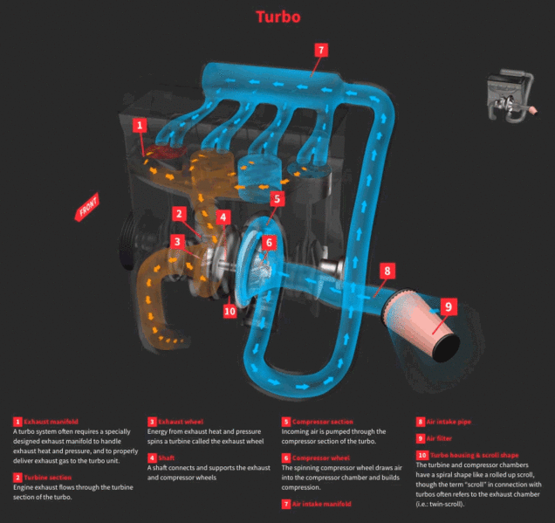
Turbo Engine

Slide 23
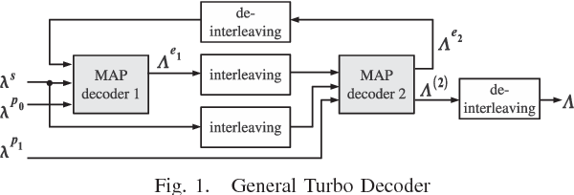
Turbo Decoder
the idea of turbo decoding is using two soft input soft output (siso) decoders

Slide 24
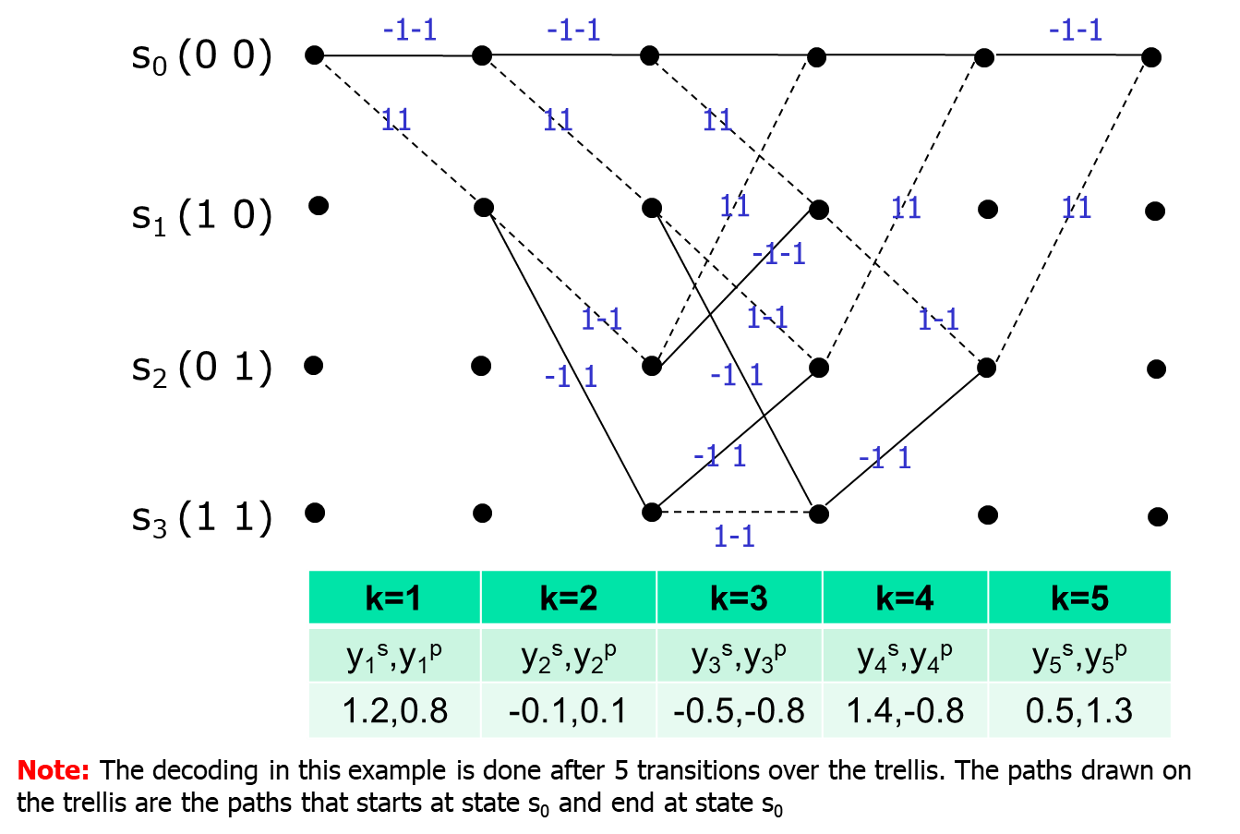
An Example of MAP Algorithm

Slide 25
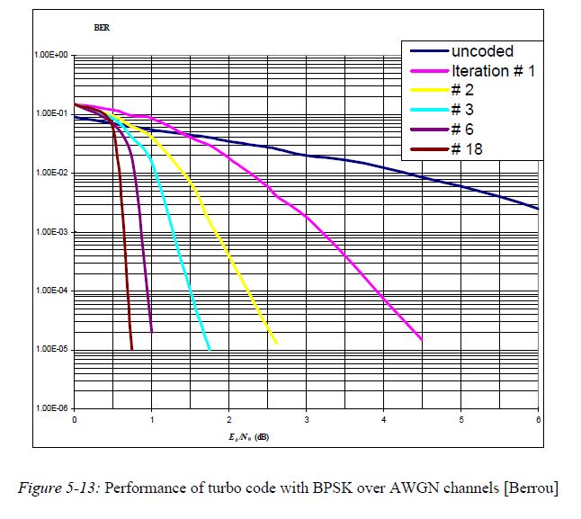
Turbo Code Error-Performance
Iterative decoding is a key feature of turbo codes. Each decoding iteration results in additional computations and decoding delay
number M is chosen, and each frame is decoded for M iterations
Usually, M is set with the worst corrupted frames in mind

Slide 26
Orthogonal frequency-division multiplexing (OFDM)

Slide 27

History Of Ofdm
OFDM is a frequency-division multiplexing (FDM) scheme that was introduced by Robert W. Chang of Bell Labs in 1966.
improved by Weinstein and Ebert in 1971 with the introduction of a guard interval.
802.11a was one of the first standards issued under the 802.11 umbrella in 1999.

Slide 28
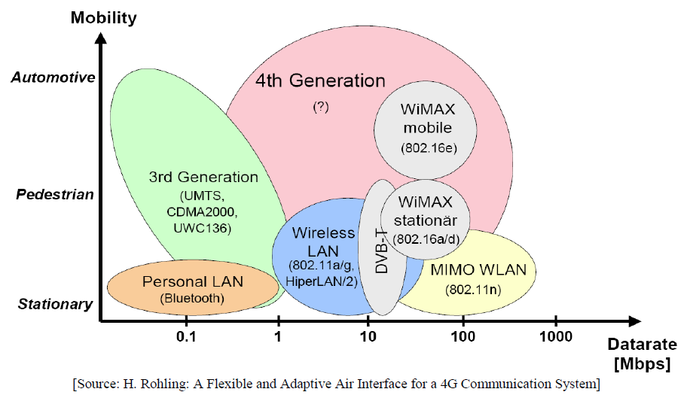
Evolution of Wireless Communication Standards
OFDM

Slide 29
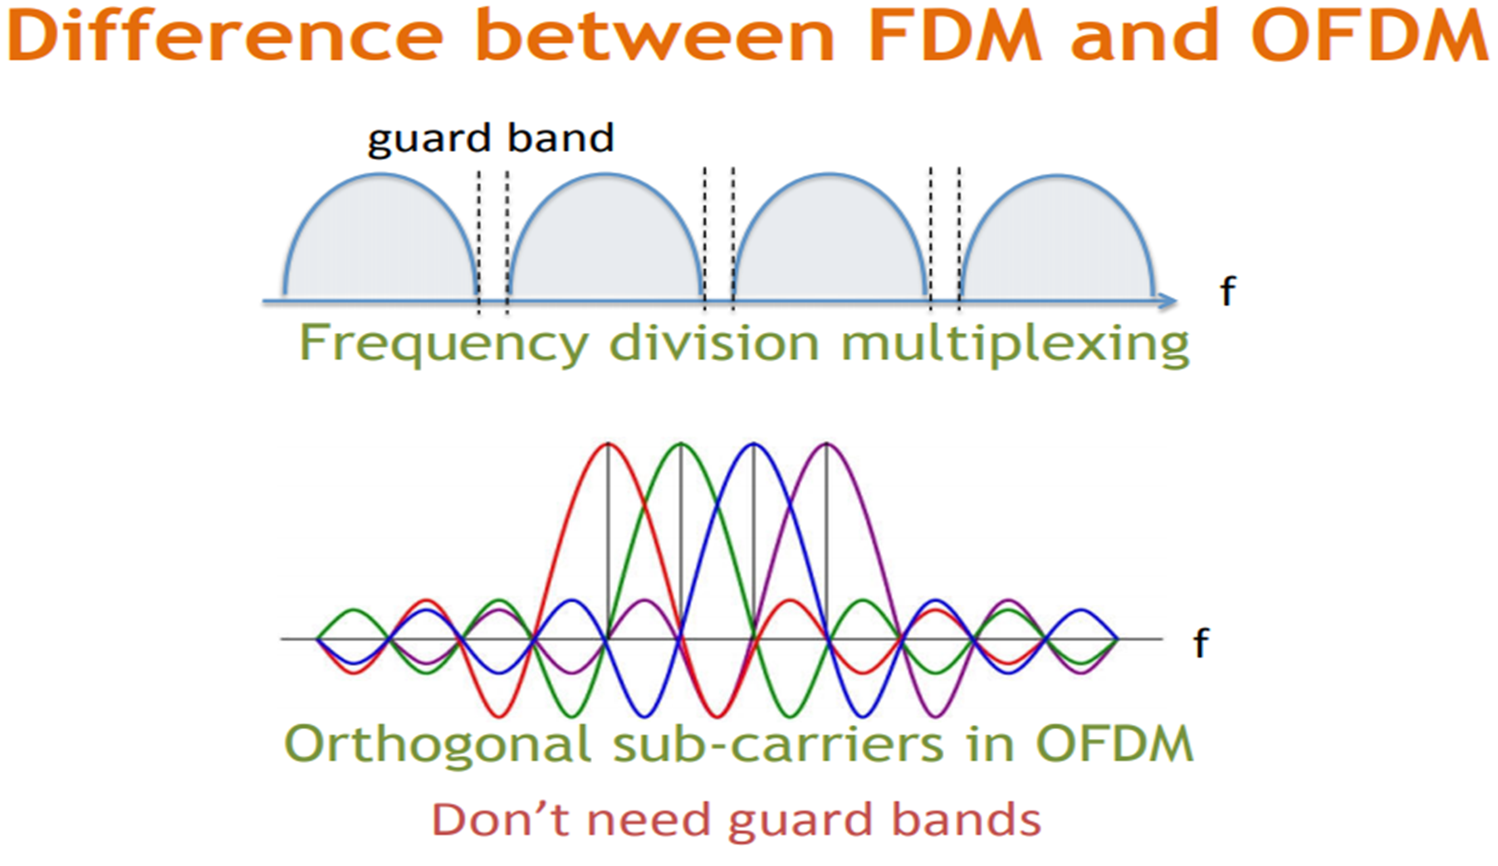

Slide 30
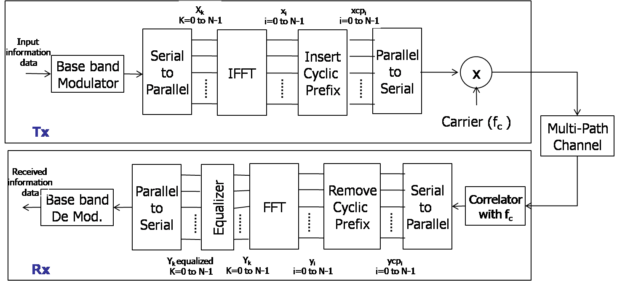
Ofdm Diagram

Slide 31
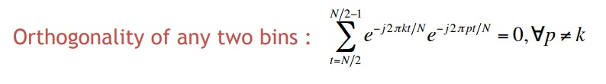
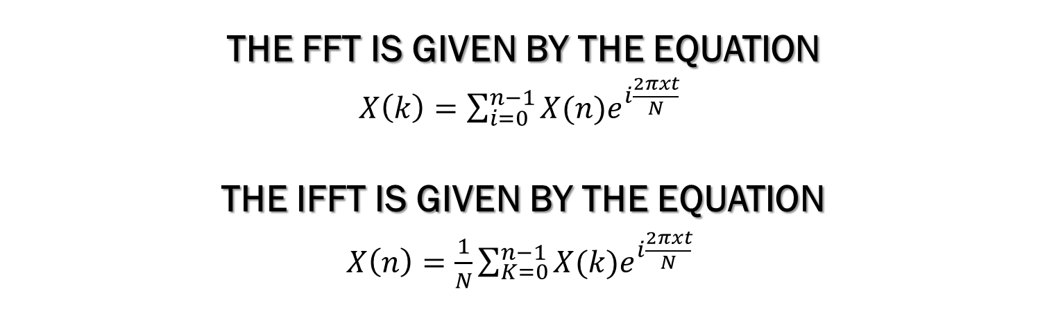
Orthogonality of Sub-Carriers
The FFT is given by the equation
$X\left(k\right)=\sum_{i=0}^{n−1}{X(n)e^{i\frac{2πxt}{N}}}$
The IFFT is given by the equation
$X\left(n\right)=\frac{1}{N}\sum_{K=0}^{n−1}{X(k)e^{i\frac{2πxt}{N}}}$

Slide 33
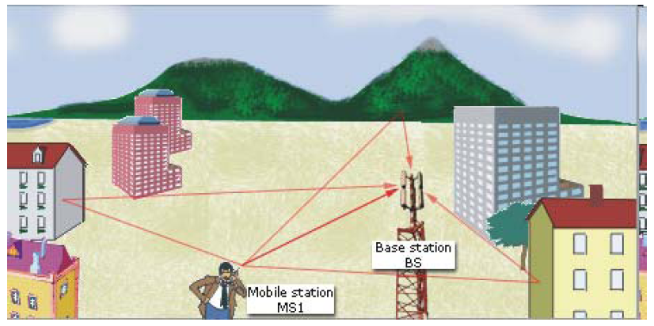
Multipath Fading
Communications over wireless channels suffer from multi-path propagation
Multi-path channels are usually frequency selective
OFDM supports high data rate communications over frequency selective channels
From “Wireless Communications” Edfors, Molisch, Tufvesson

Slide 34
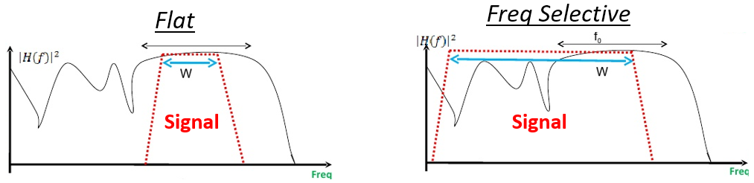
Multipath Fading

Slide 35
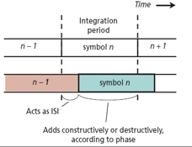
Inter Symbol Interference (ISI)
Inter symbol interference (ISI) occurs when a pulse spreads out in such a way that it interferes with adjacent at the sample instant.
we have two main problems from multipath .
Interference between adjacent symbols (Inter symbol interference).
Interference between different copies of the same data (Intra- symbol interference).

Slide 36
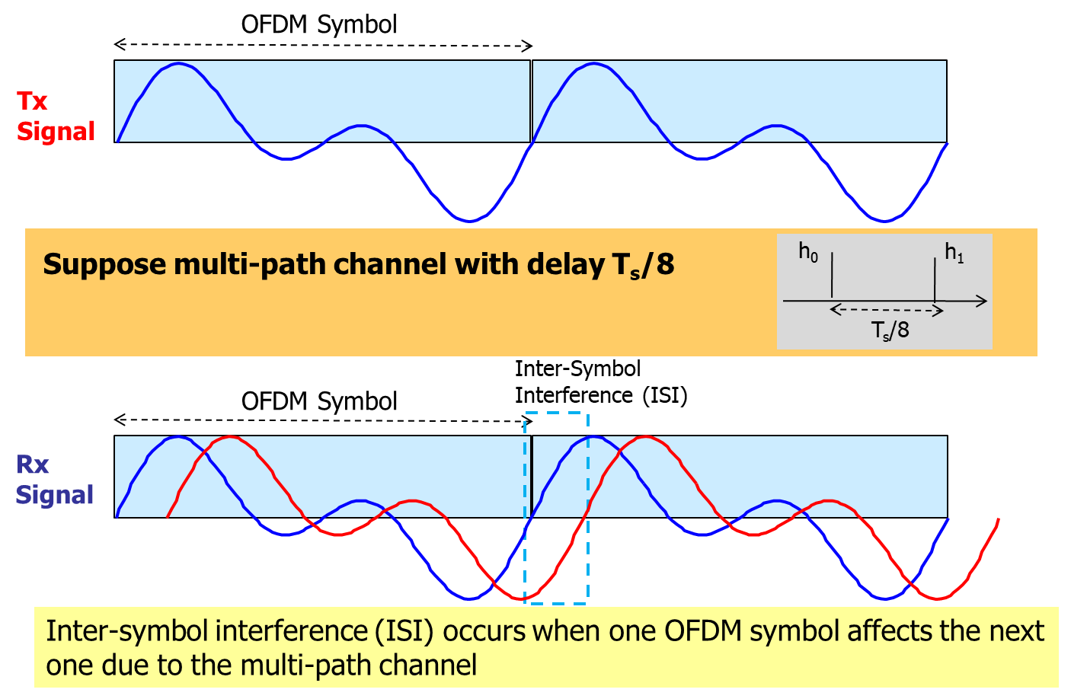
Intersymbol Interference in OFDM

Slide 37
Inserting Guard Time
OFDM Symbol
Guard Time eliminates ISI between neighboring OFDM symbols
However each OFDM symbol suffers from inter-carrier interference (ICI)
Guard time corresponds to a reduction of bit rate
Tx Signal
T_{s}/8
T_{s}
T_{s}
T_{s}/4
Guard Time
Suppose multi-path channel with delay T_{s}/8
h₀
h₁
T_{s}/8
Rx Signal
T_{s}/8
T_{s}
T_{s}
T_{s}/4
Guard Time
No ISI

Slide 38
Cyclic Prefix (CP)
The basic concept behind the OFDM cyclic prefix is quite straight forward.
The cyclic prefix performs two main function.
The cyclic prefix provides a guard interval to eliminate inter symbol interference from the previous symbol.
It repeats the end of the symbol so the linear convolution of a frequency-selective multipath channel can be modelled as circular convolution.
The cyclic prefix is created so that each OFDM symbol is preceded by a copy of the end part of that same symbol.
Different OFDM cyclic prefix lengths are available in various systems. For example within LTE a normal length and an extended length are available and after Release 8 a third extended length is also included, although not normally used

Slide 39
Cyclic Prefix
The cyclic prefix is used to eliminate Inter-carrier interference
Tx Signal (Guard Time)
Tx Signal (Cyclix Prefix)
OFDM Symbol
OFDM Symbol
T_{s}/8
T_{s}
T_{s}/8
T_{s}/8
T_{s}
Guard Time
Cyclic Prefix
Cyclic Prefix
+
+
Cyclic Prefix

Slide 40
Rx Signal (Cyclix Prefix)
Consider the receiver for f₁=1/T_{s} that correlates over T_{s} with
Cyclic Prefix
T_{s}/8
T_{s}/8
T_{s}
T_{s}
Orthogonal
x
Correlation at Rx over T_{s}
+
No Inter-Carrier Interference

Slide 41

Team Names
Mohamed Ahmed Mahmoud Ahmed Khedawy
Mohamed Soliman Alsaid Soliman Hassab
Ahmed Hamdy Abdelfattah Saber Alesh
Ahmed Mohamed Abdulrahman Elwan
Mohamed Saied Mohamed Osman
Mohamed Magdi Soliman Hamda

